Slide 1
Semi-supervised Learning of MNLI by Conditional Cycle Unified Language Model with Reasoning
Haoming Jiang

Slide 2
Outline
Background
Challenges and Current Advances
Proposed Method

Slide 3
Multi-Genre Natural Language Inference (MNLI)
Natural Language Inference
(Premise, Hypothesis, Relationship)
Examples:
Contradiction :
Met my first girlfriend today. ⬄ I didn’t meet my first girlfriend.
Entailment:
At 8:34, the Boston Center controller received a third transmission ⬄ The Boston Center controller got a third transmission
Neutral:
I am a lacto-vegetarian. ⬄ I enjoy eating cheese
5 domains for training, 10 domains for testing

Slide 4
Outline
Background
Challenges and Current Advances
Proposed Method

Slide 5
Challenges
Limited Paired Labeled Data

Slide 6
Challenges
Limited Paired Labeled Data
Solution 1: Data Augmentation
Solution 2: Learn From Unlabeled Data: Semi-supervised Learning
Solution 3: Learn From Unlabeled Data: Language Model Pretraining

Slide 7

Solution
Solution 1: Data Augmentation (Xie et al. 2019)
Back translation; TF-IDF based word replacing
$\left(x,y,l\right)→(x^{′},y^{′},l)$
Pros: label is known
Cons: knowledge is limited
Labeled Data
Augmented Data

Slide 8







Solution
Solution 2: Learn From Unlabeled Data: Semi-supervised Learning (Ruder et al. 2019)
Self-training, Tri-training
Pros: Unlimited unlabeled data
Cons: Pairing is hard
Labeled Data:
$$(x_{1},y_{1},l_{1})$$
$$(x_{2},y_{2},l_{2})$$
…
$$(x_{n},y_{n},l_{n})$$
Semi-supervised
Learning
Combinatorial, NP-Hard
Model
Unlabeled Data:
Pairing
Labeled Data:
$$({x^{′}}_{1},{x^{′}}_{3},?)$$
$$({x^{′}}_{3},{x^{′}}_{n},?)$$
…
$$({x′}_{m},{x′}_{n},?)$$
$${x′}_{1}$$
$${x′}_{3}$$
$${x′}_{2}$$
$${x′}_{n}$$
$${x′}_{m}$$

Slide 9
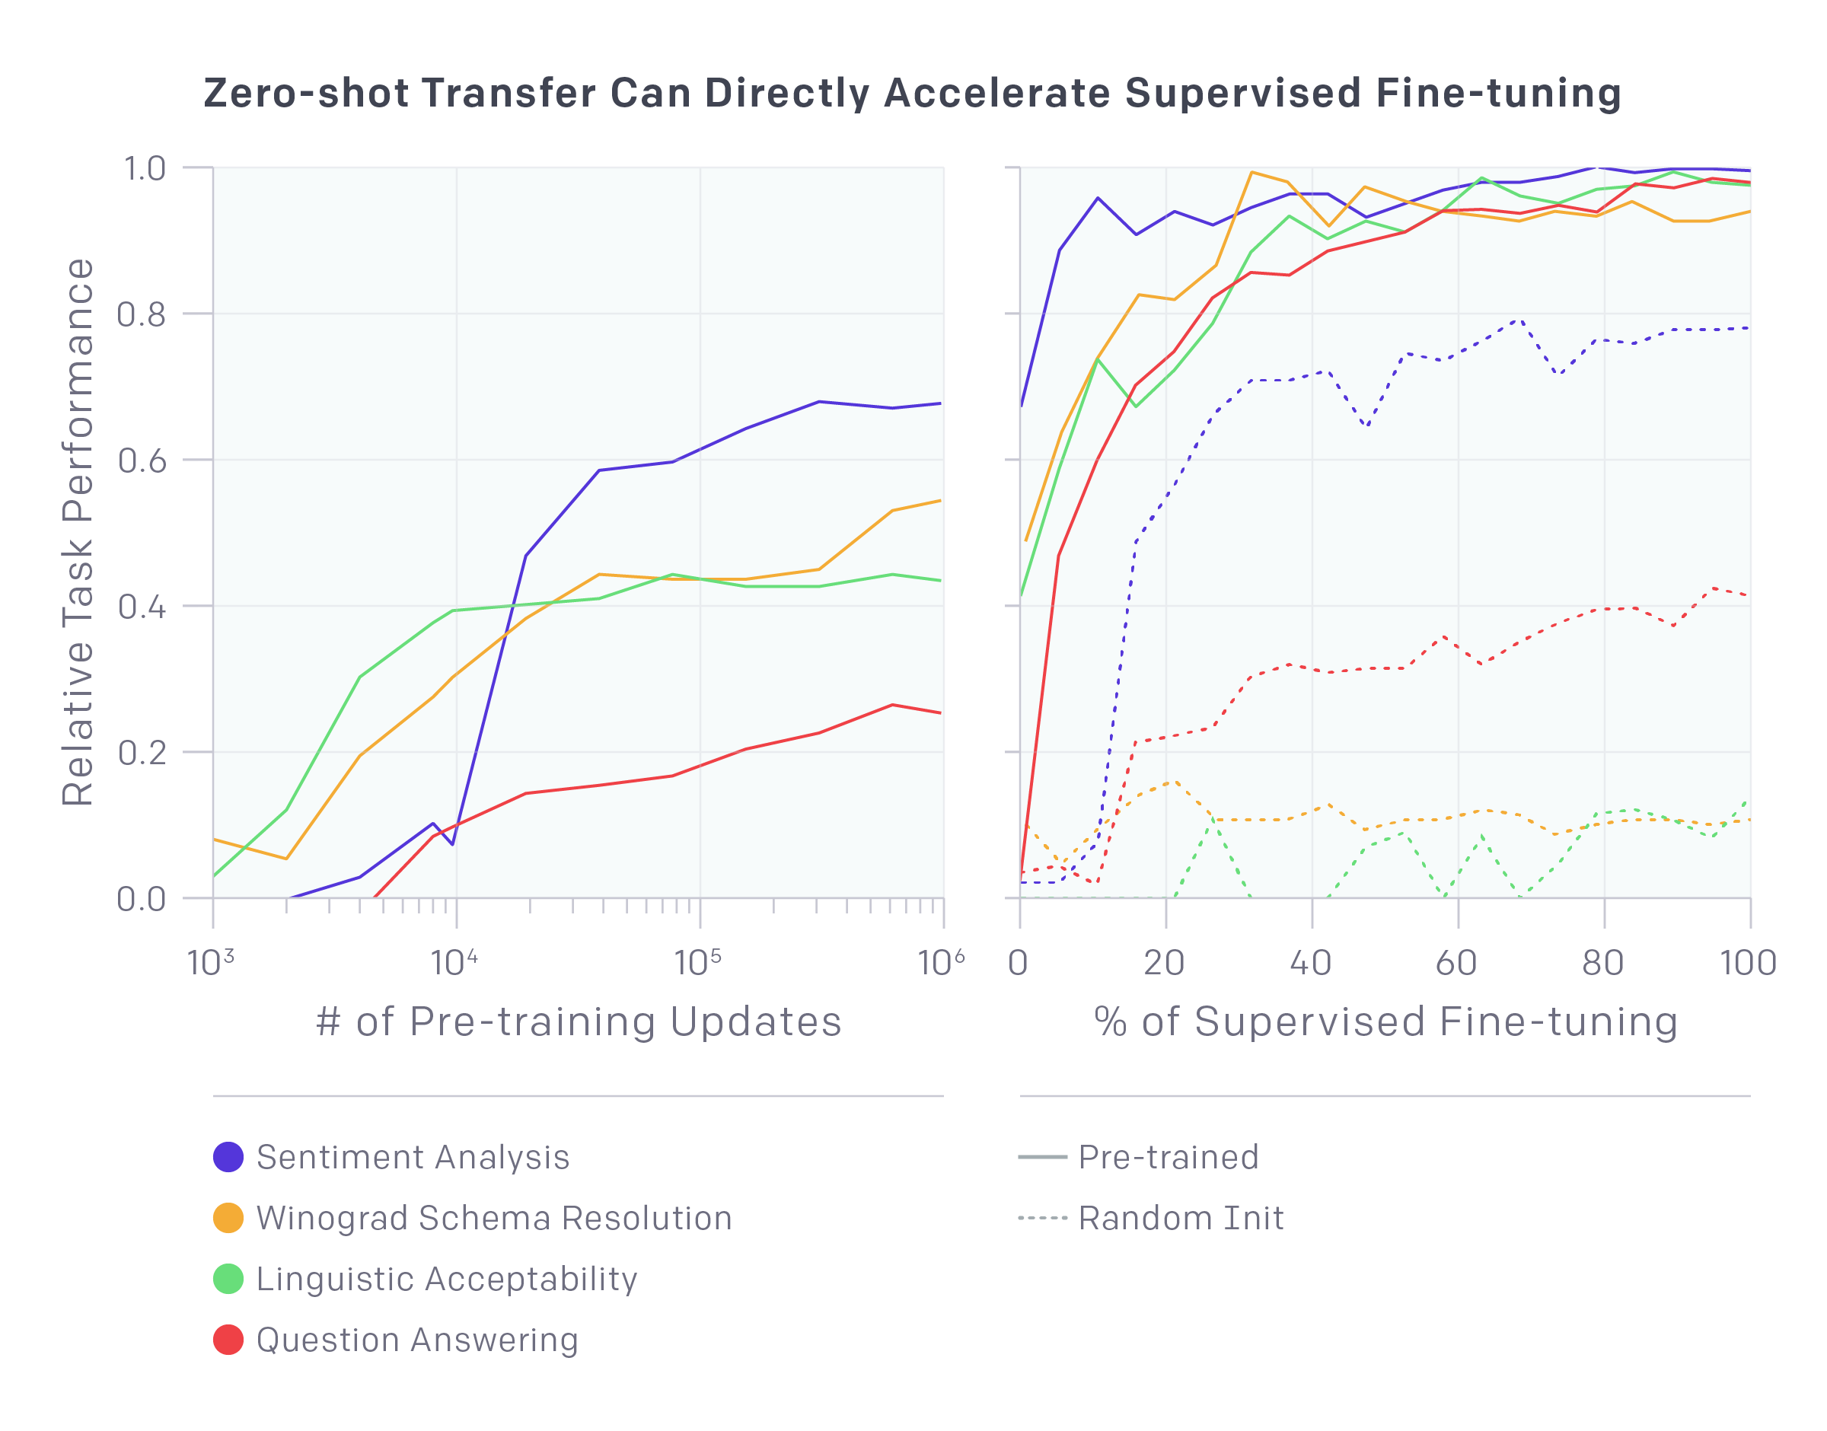
Solution
Method 3: Learn From Unlabeled Data: Language Model Pretraining
Pretrain Model → Fine tuning (GPT, GPT-2, BERT,…)

Slide 10
Solution
Method 3: Learn From Unlabeled Data: Language Model Pretraining
Pretrain Model → Fine tuning (GPT, GPT-2, BERT,…)
Pros: Unlimited unlabeled data
Cons: No label; No pair; Not task specific
Labeled Data
Augmented Data
Unlabeled Data

Slide 11
Can we do better?
Method | Amount | Pair | Label | Task Specific
Data Augmentation | Limited | Yes | Yes (Ground Truth) | Yes
Semi-supervised Learning | Unlimited | Hard | Pseudo Label (Self Training) | Yes
Pretraining | Unlimited | No | No | No
Ideal | Unlimited | Reliable and Easy | Reliable and Easy | Yes
Problem 1: How to make use of unlimited unlabeled data?
Problem 2: How to find pairs for the unlabeled data?
Problem 3: How to get reliable pseudo label?

Slide 12
Outline
Background
Challenges and Current Advances
Proposed Method

Slide 13

Proposed Method: Conditional Cycle-ULM
Classification model $F(x)$
Unsupervised Learning by Language Model: $Q(x)$
Pairing by Seq2Seq: $x→y=G(x)$
Label → Conditional Generation: $x,l→y=G(x,l)$
Reliability → Cycle Consistency:
$$y=G\left(x,contradict\right)⇔x=G\left(y,contradict\right)$$
$$y=G\left(x,neutral\right)⇔x=G\left(y,neutral\right)$$
Entailment is not symmetric! Two possible solutions
$$\text{C}\text{hain} \text{rule}\text{:} y=G\left(x,entail\right),z=G\left(y,entail\right)⇒z=G\left(x,entail\right)$$
$$\text{or} \text{New} \text{label}\text{: }y=G\left(x,entail\right)⇔x=G\left(y,entailed by\right)$$
Unified Language Model (ULM)

Slide 14
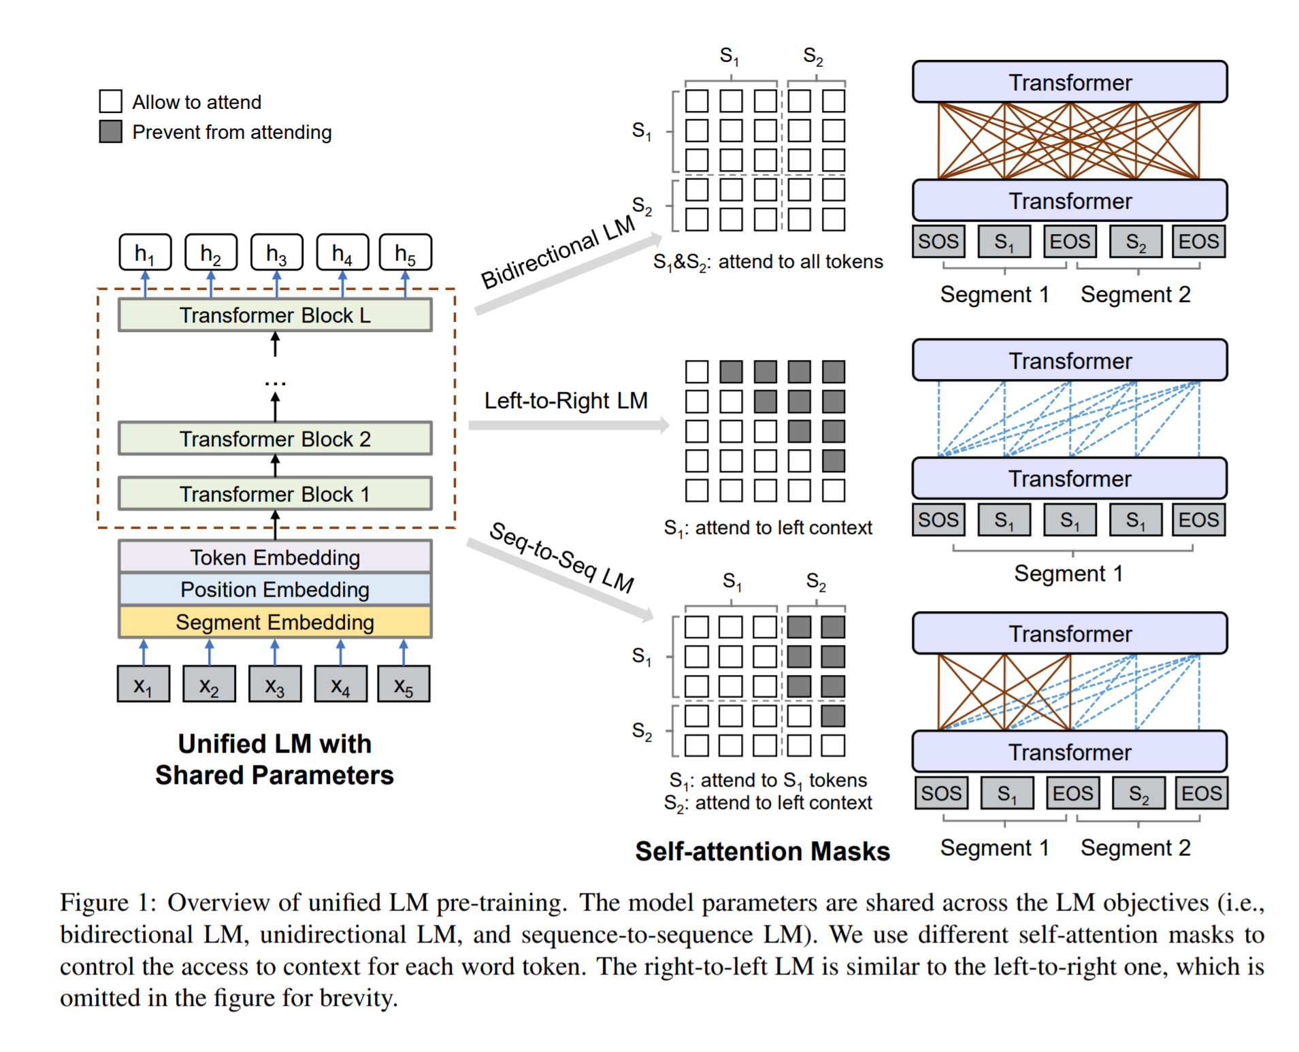
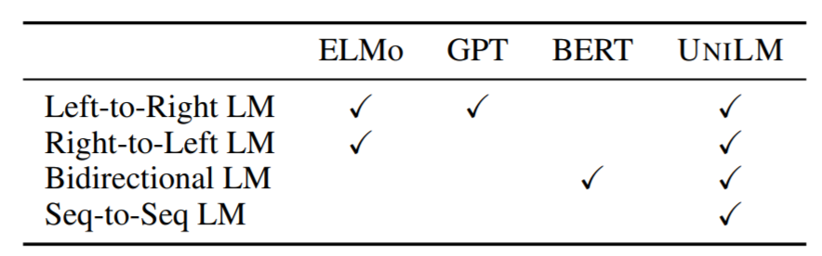

Modeling: Conditional Cycle-ULM
Unified Language Model (ULM) (Dong et al. 2019)
Powerful Probabilistic Modeling Tool
Language Modeling $p(x)$
Seq2Seq $p\left(y | x\right)$
Classification $p\left(l | x,y\right)$

Slide 15

Proposed Method: Conditional Cycle-ULM
Classification model $F(x)$
Unsupervised Learning by Language Model: $Q(x)$
Pairing by Seq2Seq: $x→y=G(x)$
Label → Conditional Generation: $x,l→y=G(x,l)$
Reliability → Cycle Consistency:
$$y=G\left(x,contradict\right)⇔x=G\left(y,contradict\right)$$
$$y=G\left(x,neutral\right)⇔x=G\left(y,neutral\right)$$
Entailment is not symmetric! Two possible solutions
$$\text{C}\text{hain} \text{rule}\text{:} y=G\left(x,entail\right),z=G\left(y,entail\right)⇒z=G\left(x,entail\right)$$
$$\text{or} \text{New} \text{label}\text{: }y=G\left(x,entail\right)⇔x=G\left(y,entailed by\right)$$
Unified Language Model (ULM)
Conditional ULM

Slide 16

Modeling: Conditional Cycle-ULM
Seq2Seq models the probability in a recursive way:
$$p\left(y | x\right)=∏p(y_{t}|y_{<t},x)$$
Conditional Seq2Seq models the conditional probability:
$$p\left(y | x,l\right)=∏p(y_{t}|y_{<t},x,l)$$
Implementation:
A shared model with different heads:
$$p\left(y_{t} | y_{<t},x,l_{1}\right)=H_{1}(F(x,y_{<t}))$$
$$p\left(y_{t} | y_{<t},x,l_{2}\right)=H_{2}(F(x,y_{<t}))$$
$$p\left(y_{t} | y_{<t},x,l_{3}\right)=H_{3}(F(x,y_{<t}))$$

Slide 17





Modeling: Conditional Cycle-ULM
Conditional ULM:
Classification
$$p\left(l | x,y\right)$$
LM
$$p(x)$$
$$p\left(y | x,contradict\right)$$
Conditional
Seq2Seq
$$p\left(y | x,neutral\right)$$
$$p\left(y | x,entail\right)$$

Slide 18

Modeling: Conditional Cycle-ULM
Relationship between classification and conditional Seq2Seq
Integrate generative model with classification model
$$p\left(l | x,y\right)∝p\left(y|x,l\right)p\left(l\right) \& p\left(l | x,y\right)∝p\left(x|y,l^{′}\right)p(l′)$$
take $p\left(l | x,y\right)=\left[\frac{p\left(y|x,l\right)p\left(l\right)}{\sum_{l}{p\left(y|x,l\right)p\left(l\right)}}+\frac{p\left(x|y,l^{′}\right)p\left(l^{′}\right)}{\sum_{l^{′}}{p\left(x|y,l^{′}\right)p\left(l^{′}\right)}}\right]/2$

Slide 19
Proposed Method: Conditional Cycle-ULM
Classification model $F(x)$
Unsupervised Learning by Language Model: $Q(x)$
Pairing by Seq2Seq: $x→y=G(x)$
Label → Conditional Generation: $x,l→y=G(x,l)$
Reliability → Cycle Consistency:
$$y=G\left(x,contradict\right)⇔x=G\left(y,contradict\right)$$
$$y=G\left(x,neutral\right)⇔x=G\left(y,neutral\right)$$
Entailment is not symmetric! Two possible solutions
$$\text{C}\text{hain} \text{rule}\text{:} y=G\left(x,entail\right),z=G\left(y,entail\right)⇒z=G\left(x,entail\right)$$
$$\text{or} \text{New} \text{label}\text{: }y=G\left(x,entail\right)⇔x=G\left(y,entailed by\right)$$
Unified Language Model (ULM)
Conditional ULM
Cycle Consistent Loss

Slide 20

Training Objective of Conditional Cycle-ULM
Part 1: Conditional Seq2Seq LM on Labeled Data:
$$\min_{G}{L_{csl}\left(D\right)=−\sum_{\left(x,y,l\right)∈D}{\log{p\left(y | x,l;G\right)}}+\log{p(x|y,l^{′};G)}}$$
Part 2: Supervised Learning on Labeled Data:
$$\min_{G}{L_{sll}\left(D\right)=−\sum_{\left(x,y,l\right)∈D}{\log{p\left(l | y,x;G\right)}} }$$
Remark:
The right part of Part1 is from cycle consistency, with the dual label $l′$

Slide 21

Training Objective of Conditional Cycle-ULM
Part 3: Cycle Consistency on Unlabeled Data:
$$\min_{G}{L_{ccu}\left(D^{′}\right)=−\sum_{x∈D^{′}}{\log{p(x| \hat{y},l^{′};G)}}}$$
Part 4: Supervised Learning on Unlabeled Data:
$$\min_{G}{L_{slu}\left(D^{′}\right)=−\sum_{x∈D^{′}}{\log{p\left(l | x,\hat{y};G\right)}} }$$
Here
$$\hat{y}=\arg{\max{p\left(y | x,l\right)}}$$
$$l\sim Uniform(\{contradiction, neutral, entailment,entailed by\})$$

Slide 22

Training Objective of Conditional Cycle-ULM
Final Objective:
$$L{={λ_{csl}L}_{csl}\left(D\right)+λ_{sll}L_{sll}\left(D\right)}$$
$$+λ_{ccu}L_{ccu}\left(D^{′}\right)+λ_{slu}L_{slu}\left(D^{′}\right)$$
$$+λ_{ULM}L_{ULM}(\{D,D′\})$$
$λ_{csl},λ_{sll},λ_{ccu},λ_{slu},λ_{ULM}$ are trade off parameters
$L_{ULM}$ is from the unsupervised pretraining (Dong et al. 2019)
Unidirectional LM
Bidirectional LM
Seq2Seq LM

Slide 23

Training Scheme
Scheme 1: joint training of all objectives in a multitask way
Adjust trade off parameters $λ_{csl},λ_{sll},λ_{ccu},λ_{slu},λ_{ULM}$ during the training. Gradually increasing the noisy signal from unlabeled data to prevent overfitting the noise.

Slide 24

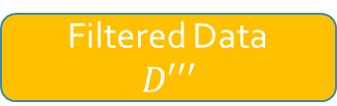

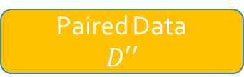


Training Scheme
Scheme 2: Multi-Stage Training
Labeled Data $D$
MNLI Classification
$L_{sll}+L_{slu}$
Unlabeled Data $D′$
Augment
Generative Model
$$L_{csl}+L_{sll}$$
Filter
Paired Data
$D′′$
Rule Base Filter:
e.g., lookup in Wiki
Filtered Data
$D′′′$

Slide 25

Other Challenges
Diversity
Sample suboptimal: $\hat{y}≃\arg{\max{p\left(y | x,l\right)}}$
Inject random noise: $\hat{y}=\arg{\max{p\left(y | x+δ,l\right)}}$
Domain Mismatch
Hopefully, the large scale out-domain unlabeled data can help with that

